Slide 1

Towards Top-Down Just Noticeable Difference Estimation of Natural Images
IEEE Transactions on Image Processing, 2022
Qiuping Jiang¹, Zhentao Liu¹, Shiqi Wang², Feng Shao¹, Weisi Lin³
1. Ningbo University,
2. City University of Hong Kong,
3. Nanyang Technological University

Slide 2
OUTLINE
Introduction
Mathematical definition of JND
Design philosophy comparison
KLTJND: Top-Down JND model based on KLT
Motivation to apply KLT
JND estimation based on CPL Image Prediction
Experimental Results
Performance comparison on direct JND prediction
JND-guided noise injection
JND-guided image compression
Conclusion

Slide 3
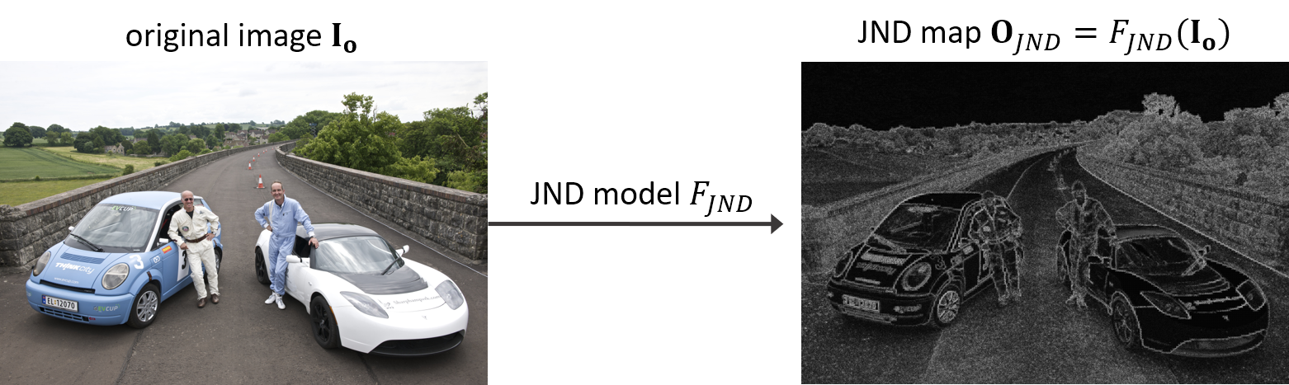
Introduction
Mathematical definition of JND
JND map represents the maximum tolerant intensity value variation of each pixel in the original image. JND model try to estimate the maximum change magnitude of each pixel that typical HVS cannot perceive.

Slide 4
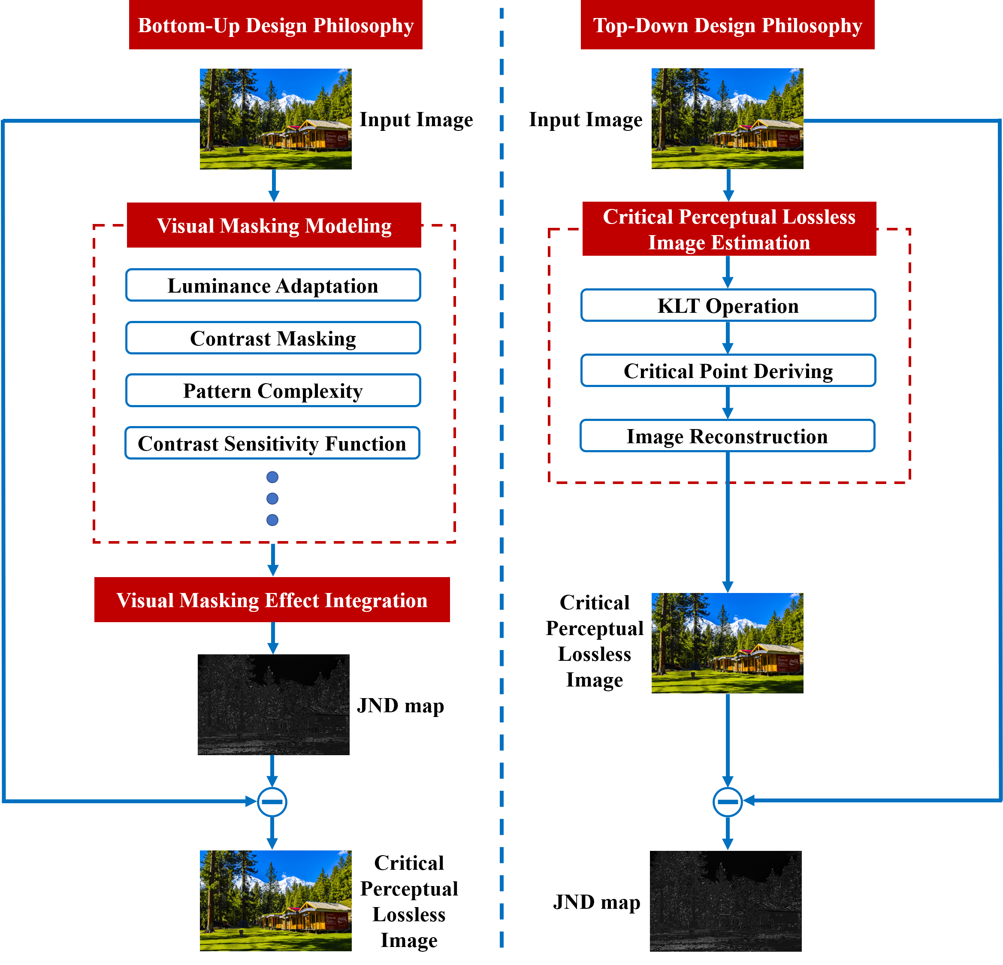
Introduction
Design philosophy comparison
KLTJND: Top-Down
CPL image estimation (KLT)
Difference map between CPL and original image
JND map
Traditional: Bottom-Up
Model contributing factors
Integrate masking effects
JND map
Drawbacks
Merits
Insufficient factors
Difficult to model their interaction
Bypassing complex and inaccurate modeling
Easy and efficient

Slide 5
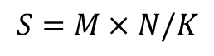
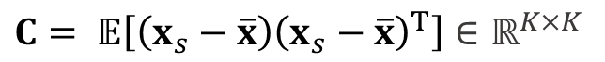
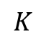
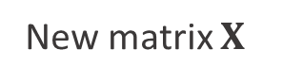
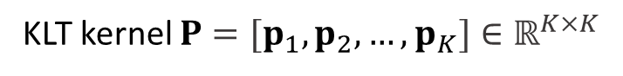
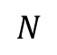
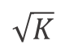

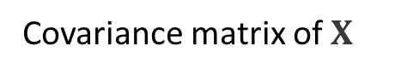
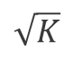
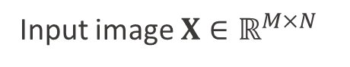

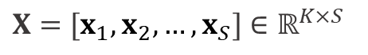
KLTJND: Top-Down JND model based on KLT
Motivation to apply KLT: theory of KLT
$$M$$
$$\sqrt{K}$$
$$1$$
$$S=M×N/K$$
$$\sqrt{K}$$
Patch vectorize
$$N$$
$$K$$
New matrix $X$
$X=[x_{1},x_{2},…,x_{S}]$ $∈ℝ^{K×S}$
Input image $X∈ℝ^{M×N}$
Eigenvalue decomposition
Arrange eigenvector according to eigenvalue in descending order to obtain
Covariance matrix of $X$
$C= 𝔼\left[\left(x_{s}−\overline{x}\right){\left(x_{s}−\overline{x}\right)}^{T}\right]$ $∈ℝ^{K×K}$
KLT kernel $P=[p_{1},p_{2},…,p_{K}]∈ℝ^{K×K}$
KLT coefficient matrix $Y=P^{T}X={[y_{1},y_{2},…,y_{K}]}^{T}$ $∈ℝ^{K×S}$, $y_{k}∈ℝ^{S}$ is the $k$-th spectral component in $Y$.

Slide 6
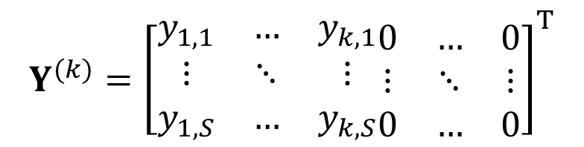
KLTJND: Top-Down JND model based on KLT
Motivation to apply KLT: image reconstruction
KLT kernel $P$ is an orthogonal matrix, thus $PP^{T}=I$, original image can be reconstructed as $X=PY$.
Take the first $k$ spectral components to obtain reconstruction KLT coefficient matrix $Y^{(k)}$ as follows:
$$Y^{(k)}={\left[\begin{matrix}y_{1,1} & … & y_{k,1} \\ ⋮ & ⋱ & ⋮ \\ y_{1,S} & … & y_{k,S}\end{matrix}\begin{matrix}0 & … & 0 \\ ⋮ & ⋱ & ⋮ \\ 0 & … & 0\end{matrix}\right]}^{T}$$
The image is reconstructed as $X^{(k)}=PY^{(k)}$ by only considering the first $k$ spectral components. And here we adopt $K=64$.

Slide 7
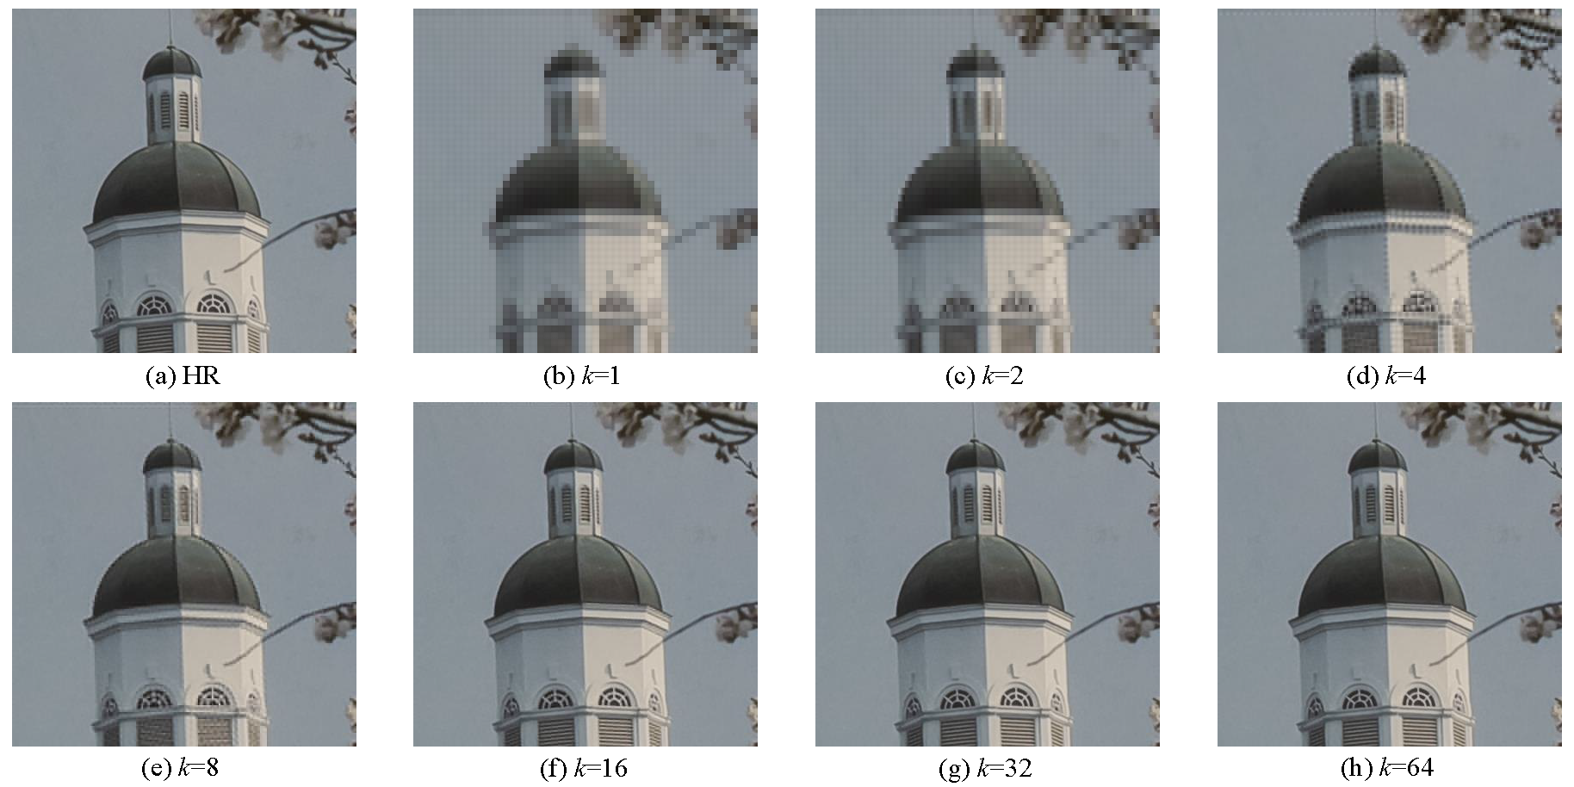
KLTJND: Top-Down JND model based on KLT
Motivation to apply KLT: image reconstruction
When $k$=16, the reconstructed image is perceptual lossless compared with the original one.

Slide 8
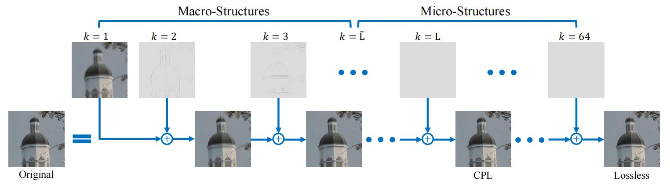
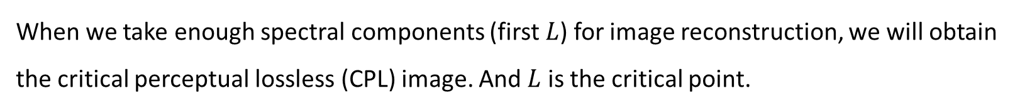
KLTJND: Top-Down JND model based on KLT
Motivation to apply KLT: image reconstruction
When we take enough spectral components (first $L$) for image reconstruction, we will obtain the critical perceptual lossless (CPL) image. And $L$ is the critical point.

Slide 9
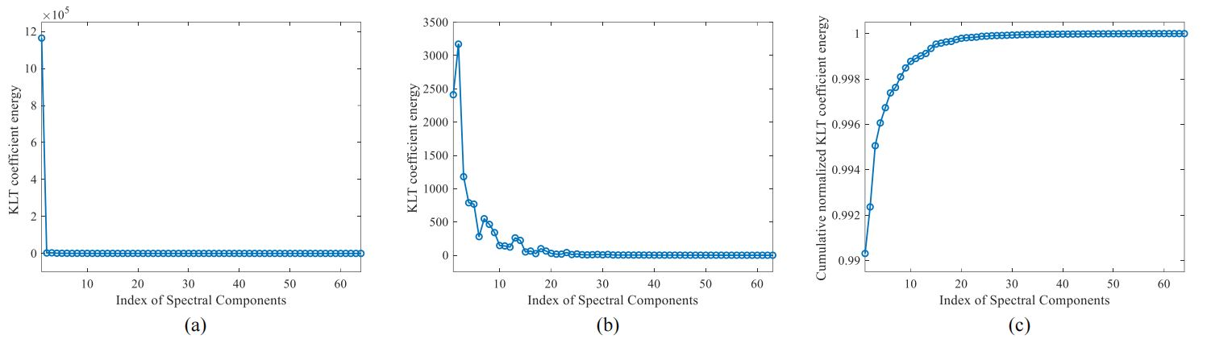
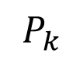
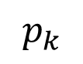
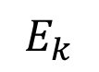
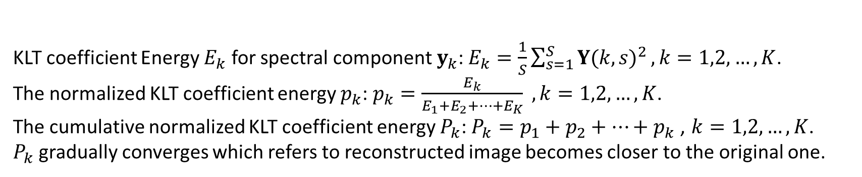
KLTJND: Top-Down JND model based on KLT
JND estimation based on CPL image prediction
Convergence Property of KLT Coefficient Energy
$$E_{k}$$
$$p_{k}$$
$$P_{k}$$
KLT coefficient Energy $E_{k}$ for spectral component $y_{k}$: $E_{k}=\frac{1}{S}\sum_{s=1}^{S}{Y{(k,s)}^{2}}, k=1,2,…,K$.
The normalized KLT coefficient energy $p_{k}$: $p_{k}=\frac{E_{k}}{E_{1}+E_{2}+…+E_{K}} , k=1,2,…,K$.
The cumulative normalized KLT coefficient energy $P_{k}$: $P_{k}=p_{1}+p_{2}+…+p_{k}$ , $k=1,2,…,K$.
$P_{k}$ gradually converges which refers to reconstructed image becomes closer to the original one.

Slide 10
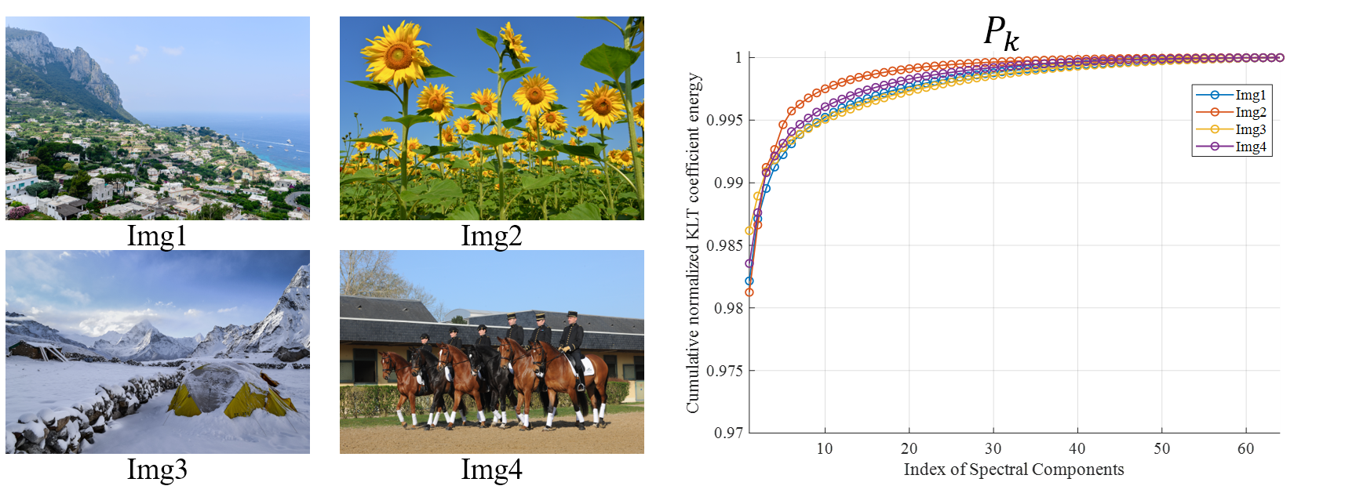
KLTJND: Top-Down JND model based on KLT
JND estimation based on CPL image prediction
Convergence Property of KLT Coefficient Energy
For images with different contents, although their cumulative distribution curves have the same convergence tendency, their critical points that lead to sufficient visual information may be different.

Slide 11
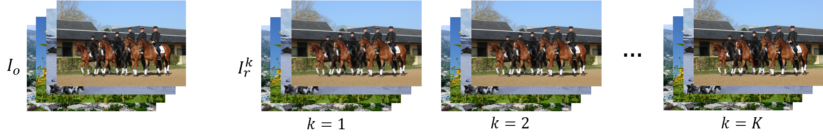
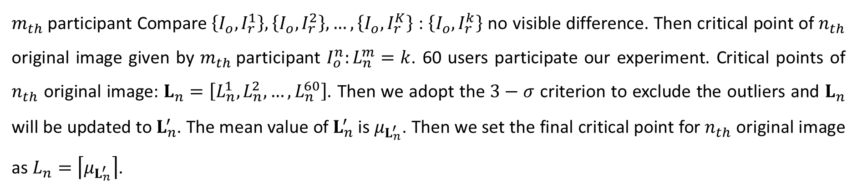
KLTJND: Top-Down JND model based on KLT
JND estimation based on CPL image prediction
Critical Point Derivation
500 images from DIV2K
Reconstructed image using the first $k$ spectral component, $k=1,2,…,K$
$m_{th}$participant Compare $\left\{I_{o},I_{r}^{1}\right\},\left\{I_{o},I_{r}^{2}\right\},…,\left\{I_{o},I_{r}^{K}\right\}$ : $\left\{I_{o},I_{r}^{k}\right\}$ no visible difference. Then critical point of $n_{th}$ original image given by $m_{th}$participant $I_{o}^{n}:L_{n}^{m}=k$. 60 users participate our experiment. Critical points of $n_{th}$ original image: $L_{n}=\left[L_{n}^{1},L_{n}^{2},…,L_{n}^{60}\right]$. Then we adopt the $3−σ$ criterion to exclude the outliers and $L_{n}$ will be updated to $L_{n}^{′}$. The mean value of $L_{n}^{′}$ is $μ_{L_{n}^{′}}$. Then we set the final critical point for $n_{th}$ original image as $L_{n}=\left\lceil μ_{L_{n}^{′}}\right\rceil$.
Notes:
DIV2K:
[1] R. Timofte et al., “NTIRE 2017 challenge on single image super-resolution: Methods and results,” in 2017 IEEE Conference on Computer Vision and Pattern Recognition Workshops (CVPRW), 2017, pp. 1110–1121.
[2] E. Agustsson and R. Timofte, “NTIRE 2017 challenge on single image super-resolution: Dataset and study,” in 2017 IEEE Conference on Computer Vision and Pattern Recognition Workshops (CVPRW), 2017, pp. 1122–1131.

Slide 12
KLTJND: Top-Down JND model based on KLT
JND estimation based on CPL image prediction
Critical Point Derivation
We apply Shapiro-Wilk test to verify the normality of the votes distribution. 13 P-value < 0.05. The votes distributions of most images conform to normal distribution.
Notes:
Shapiro-Wilk test:
[1] S. S. Shapiro and M. B. Wilk, “An analysis of variance test for normality (complete samples),” Biometrika, vol. 52, pp. 591– 611, 1965.

Slide 13
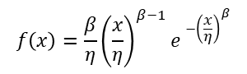
KLTJND: Top-Down JND model based on KLT
JND estimation based on CPL image prediction
Critical Point Derivation
$$f\left(x\right)=\frac{β}{η}{\left(\frac{x}{η}\right)}^{β−1}e^{⁡−{\left(\frac{x}{η}\right)}^{β}}$$
We compute $P_{L_{n}}$ for each original image and we obtain $P_{L}=\left[P_{L_{1}},P_{L_{2}},…,P_{L_{500}}\right]$. It can be well approximated by Weibull distribution. Given an input image, $L=\left\lceil \frac{\sum_{k=1}^{K}{k∙f(P_{k})}}{\sum_{k=1}^{K}{f(P_{k})}}\right\rceil$ as the critical point.

Slide 14
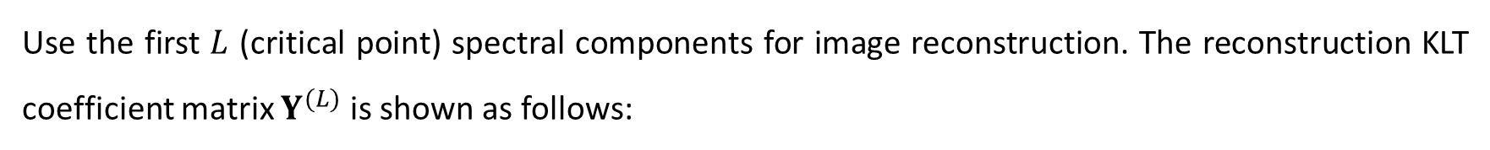
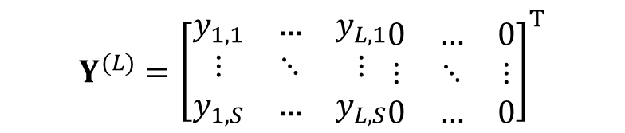
KLTJND: Top-Down JND model based on KLT
JND estimation based on CPL image prediction
CPL Image Reconstruction
Use the first $L$ (critical point) spectral components for image reconstruction. The reconstruction KLT coefficient matrix $Y^{(L)}$ is shown as follows:
$$Y^{(L)}={\left[\begin{matrix}y_{1,1} & … & y_{L,1} \\ ⋮ & ⋱ & ⋮ \\ y_{1,S} & … & y_{L,S}\end{matrix}\begin{matrix}0 & … & 0 \\ ⋮ & ⋱ & ⋮ \\ 0 & … & 0\end{matrix}\right]}^{T}$$
Then the image is reconstructed as $X^{(L)}=PY^{(L)}$, $X^{(L)}$ is the CPL image.
JND Map Estimation
With the original image $X$ and CPL image $X^{(L)}$, we could obtain the final JND map $M$ as follows:
$$M\left(i,j\right)=\left|X\left(i,j\right)−X^{\left(L\right)}(i,j)\right|$$

Slide 15
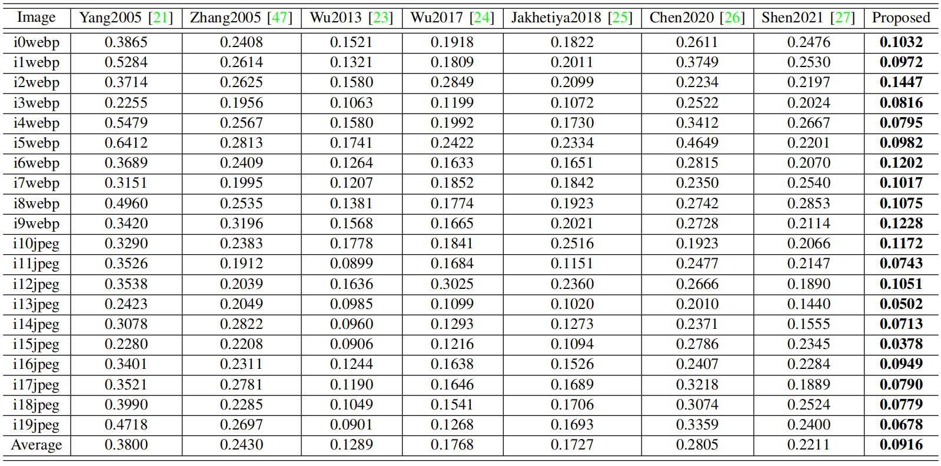
Experimental Results
Performance comparison on direct JND prediction
Performance comparison on VLT dataset
RMSE values between the predicted JND maps and the ground-truth JND map. KLTJND ranks 1st
Notes:
VLT dataset:
[1] N. Ye, K. Wolski, and R. K. Mantiuk, “Predicting visible image differences under varying display brightness and viewing distance,” in 2019 IEEE/CVF Conference on Computer Vision and Pattern Recognition (CVPR), 2019, pp. 5429–5437.

Slide 16
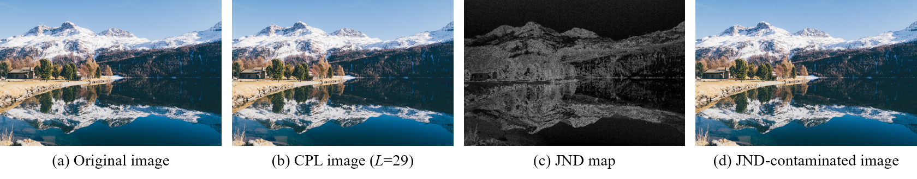
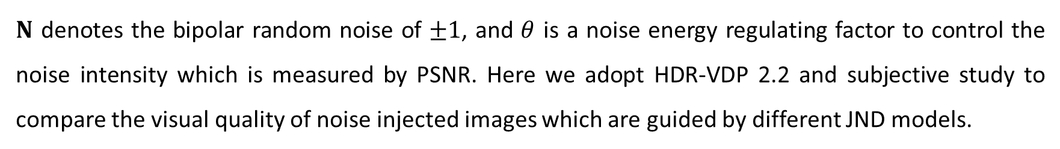
Experimental Results
JND-guided noise injection
Noise injection with the guidance of the estimated JND map is shown as follows:
$$\tilde{X}\left(i,j\right)=X\left(i,j\right)+θ∙N\left(i,j\right)∙M\left(i,j\right)$$
$N$ denotes the bipolar random noise of $±1$, and $θ$ is a noise energy regulating factor to control the noise intensity which is measured by PSNR. Here we adopt HDR-VDP 2.2 and subjective study to compare the visual quality of noise injected images which are guided by different JND models.
Notes:
HDR-VDP 2.2:
[1] R. Mantiuk, K. J. Kim, A. G. Rempel, and W. Heidrich, “HDR VDP-2: a calibrated visual metric for visibility and quality predictions in all luminance conditions,” ACM Transactions on Graphics, vol. 30, no. 4, pp. 1–14, 2011.
[2] M. Narwaria, R. K. Mantiuk, M. Silva, and P. L. Callet, “HDR VDP-2.2: a calibrated method for objective quality prediction of high-dynamic range and standard images,” Journal of Electronic Imaging, vol. 24, no. 1, p. 010501, 2014.

Slide 17
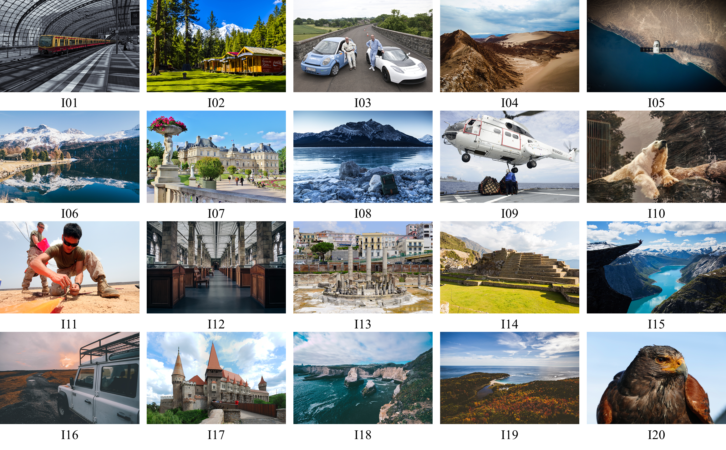
Experimental Results
JND-guided noise injection
Images selected from DIV2K as the test images for performance comparison

Slide 18
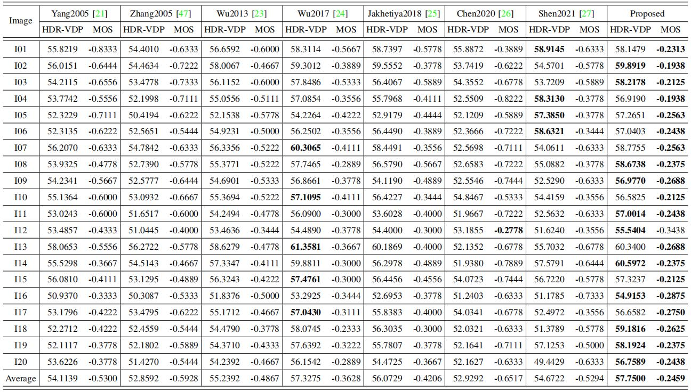
Experimental Results
JND-guided noise injection
Visual quality comparison for noise-injected images (PSNR=26dB). KLTJND ranks 1st

Slide 19
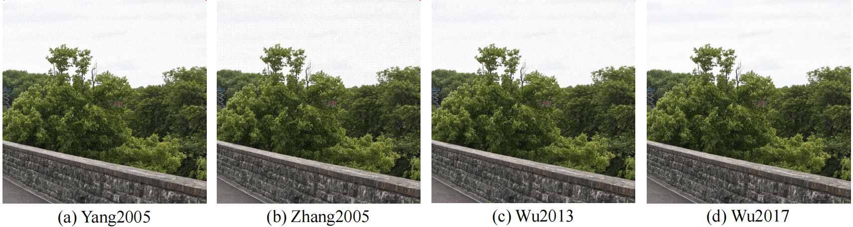
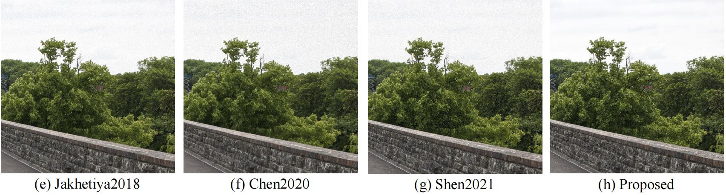
Experimental Results
JND-guided noise injection
PSNR=26dB

Slide 20
Experimental Results
JND-guided noise injection
Further more, we take HDR-VDP 2.2 as the indicator to predict the visual quality of noise injected image. Under different noise intensity, KLTJND always ranks 1st.

Slide 21
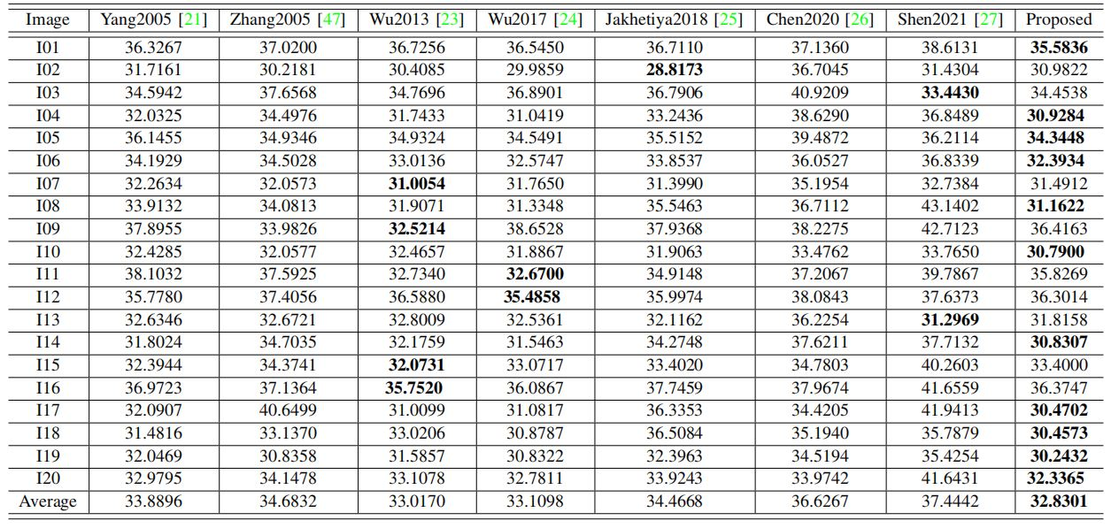
Experimental Results
JND-guided noise injection
Performance comparison on maximum tolerable noise level measured by PSNR. KLTJND ranks 1st

Slide 22
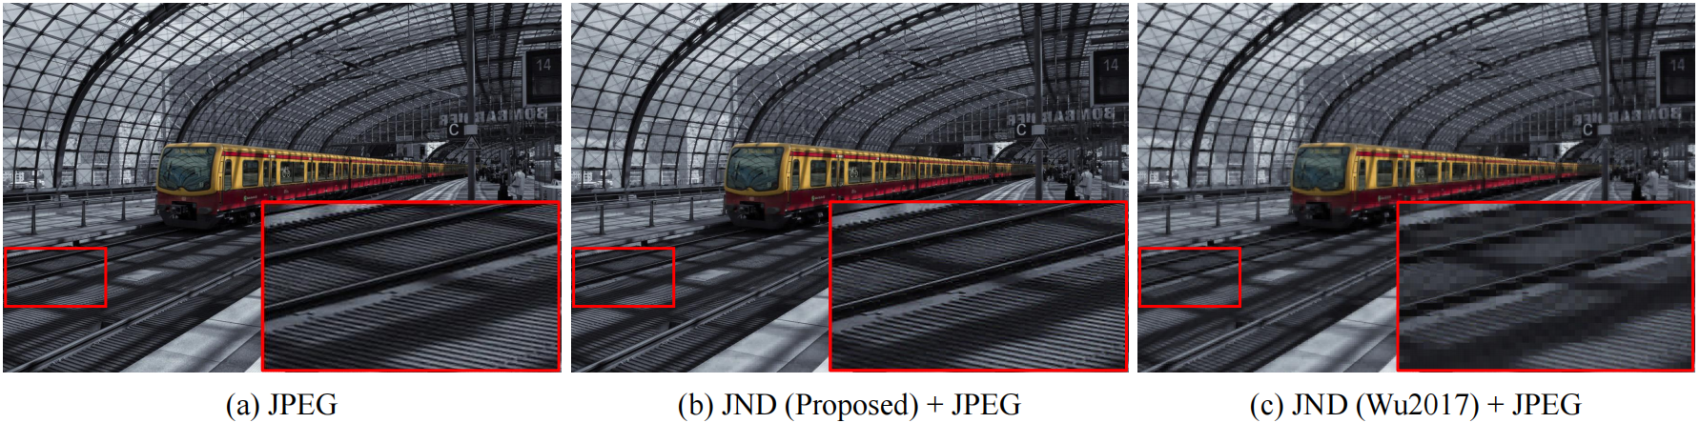
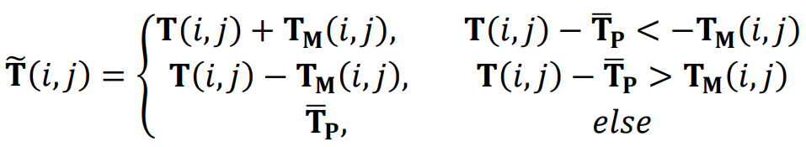
Experimental Results
JND-guided image compression
Bitrate: 0.0684 bpp
Bitrate: 0.0595 bpp
Bitrate: 0.0362 bpp
Before JPEG, we apply JND-guided preprocessor to smooth input image
Although the bitrate of Wu2017 is much lower, the visual quality of KLTJND is better.
Notes:
Wu2017:
[1] J. Wu, L. Li, W. Dong, G. Shi, W. Lin, and C.-C. J. Kuo, “Enhanced just noticeable difference model for images with pattern complexity,” IEEE Transactions on Image Processing, vol. 26, no. 6, pp. 2682–2693, 2017.

Slide 23
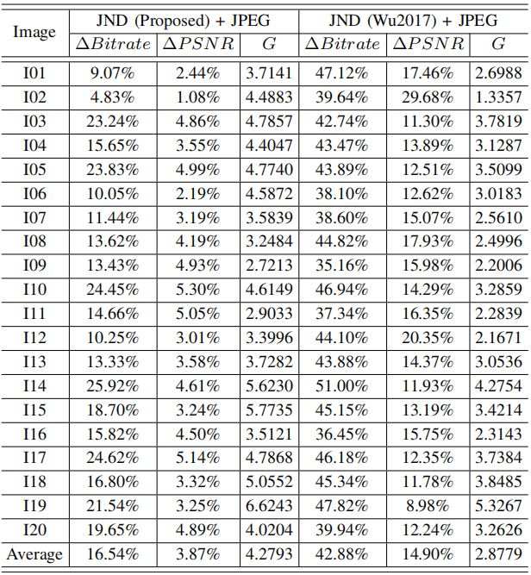
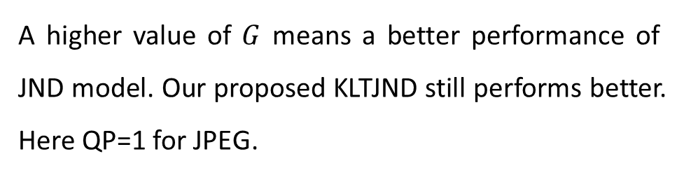
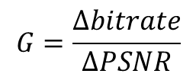
Experimental Results
JND-guided image compression
JND-guided preprocessor will reduce the bitrate and the visual quality as well. Thus we propose a new metric to indicate the performance of JND model
$$G=\frac{Δbitrate}{ΔPSNR}$$
A higher value of $G$ means a better performance of JND model. Our proposed KLTJND still performs better.
Here QP=1 for JPEG.

Slide 24
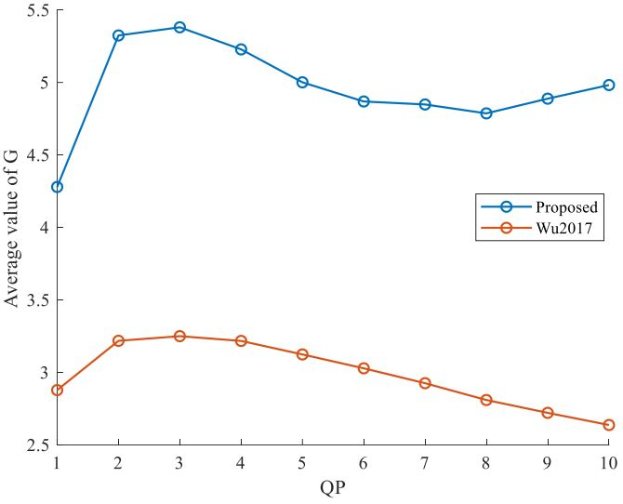
Experimental Results
JND-guided image compression
Adjust different QP value and KLTJND always performs better.

Slide 25
Conclusion
This paper has presented a novel top-down JND estimation model of natural images. It dedicates to estimating a CPL image first by exploiting the distribution characteristic of the cumulative normalized KLT coefficient energy and then calculating the difference map between the original image and CPL image as the JND map. The extensive experiments have demonstrate the superiority of our proposed model. The code are available at https://github.com/Zhentao-Liu/KLT-JND. For more detail, please refer to our paper.

